Slide 1
Project Presentation on
AI-Powered Resume Analyzer & Career Recommendation System
Team Members :-
1) Amisha Bhasme 2) Khushi Rale
3) Yash Bhagwatkar 4) Maaz Ahmad Khan
B Guided By
Dr. A. P. Jadhao
Dr. Rajendra Gode Institute of Technology & Research
Amaravati
2025-2026

Slide 2
Introduction:-
The AI-Based Career Intelligence System is a smart platform designed to help students improve their career readiness using Artificial Intelligence.
It analyzes user resumes and compares them with real job descriptions to evaluate career alignment.
The system identifies skill gaps, and checks ATS (Applicant Tracking System) compatibility.
It provides personalized career guidance, including recommended skills, courses, and etc.
The platform generates a structured learning roadmap to help students move toward their target job roles.
By automating resume analysis and career planning, the system makes career decisions more data-driven and intelligent.

Slide 3
Objective:-
To develop an AI-powered platform for intelligent resume analysis and career guidance.
To identify skill gaps between candidate profiles and industry requirements.
To calculate the ATS compatibility score for better resume optimization.
To provide personalized recommendations such as courses, skills, and projects.
To generate a structured career learning roadmap for students and job seekers.
To simplify career decision-making using data-driven insights.

Slide 4
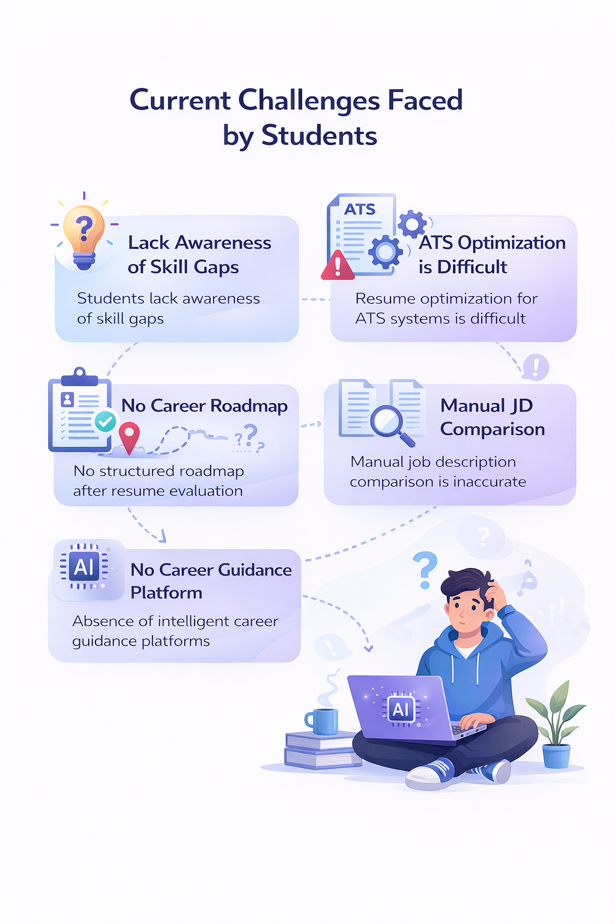
Problem Statement
Current Challenges Faced by Students
Students lack awareness of skill gaps
Resume optimization for ATS systems is difficult
No structured roadmap after resume evaluation
Manual job description comparison is inaccurate
Absence of intelligent career guidance platforms

Slide 5
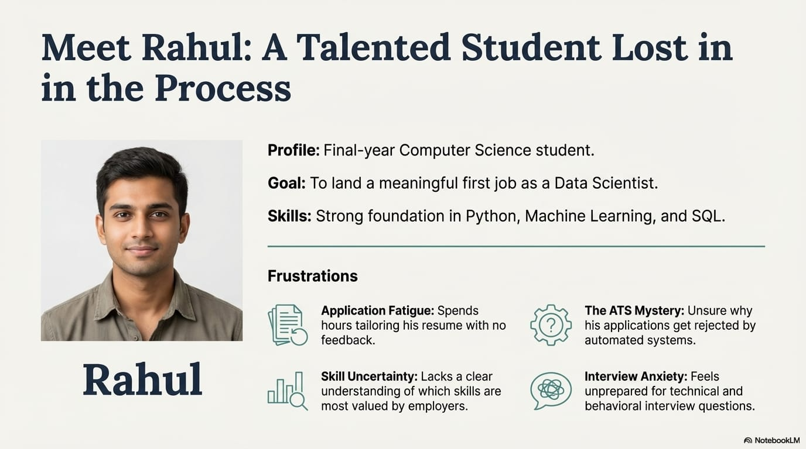
Real world Analysis(Student Challenge)

Slide 6
Proposed Solution: CAREER-AI Our System Provides :
AI-Driven Career Intelligence Platform
AI-based resume & job description analysis
ATS compatibility scoring
Automatic missing skill detection
Course & project recommendations
Personalized learning roadmap generation
AI-powered career guidance chatbot

Slide 7
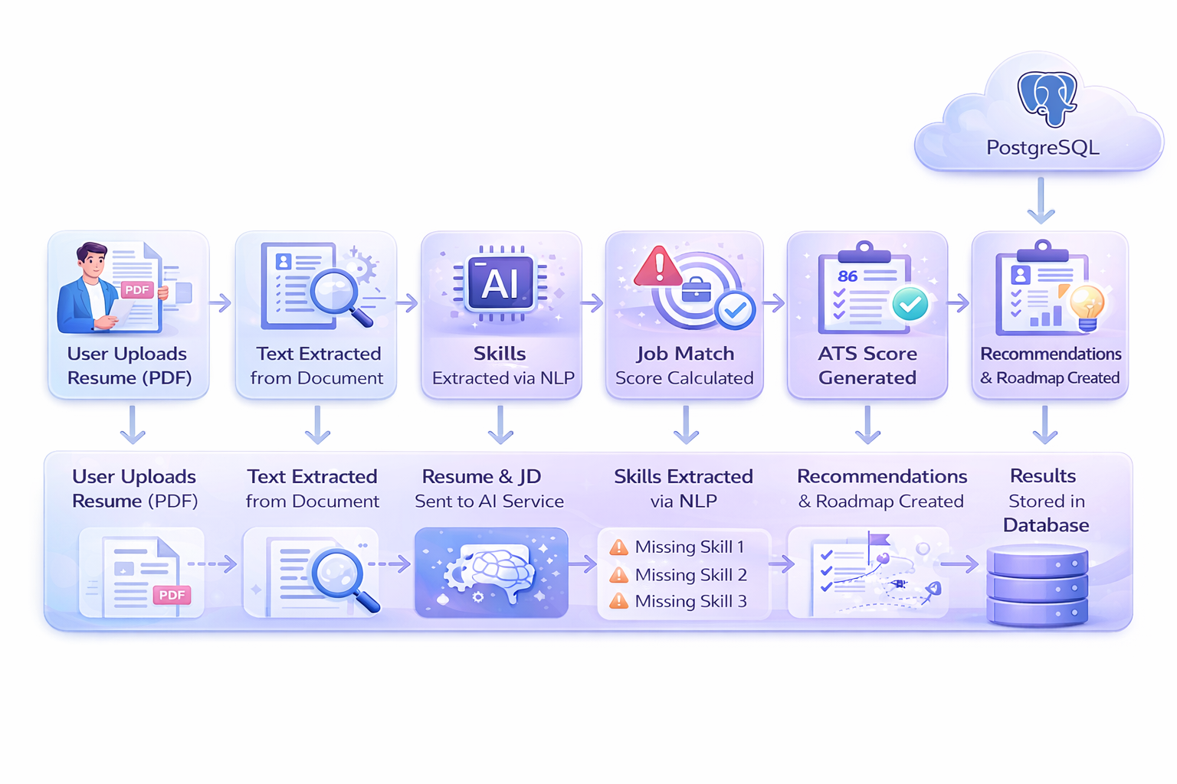
Resume Analysis Flow:

Slide 8
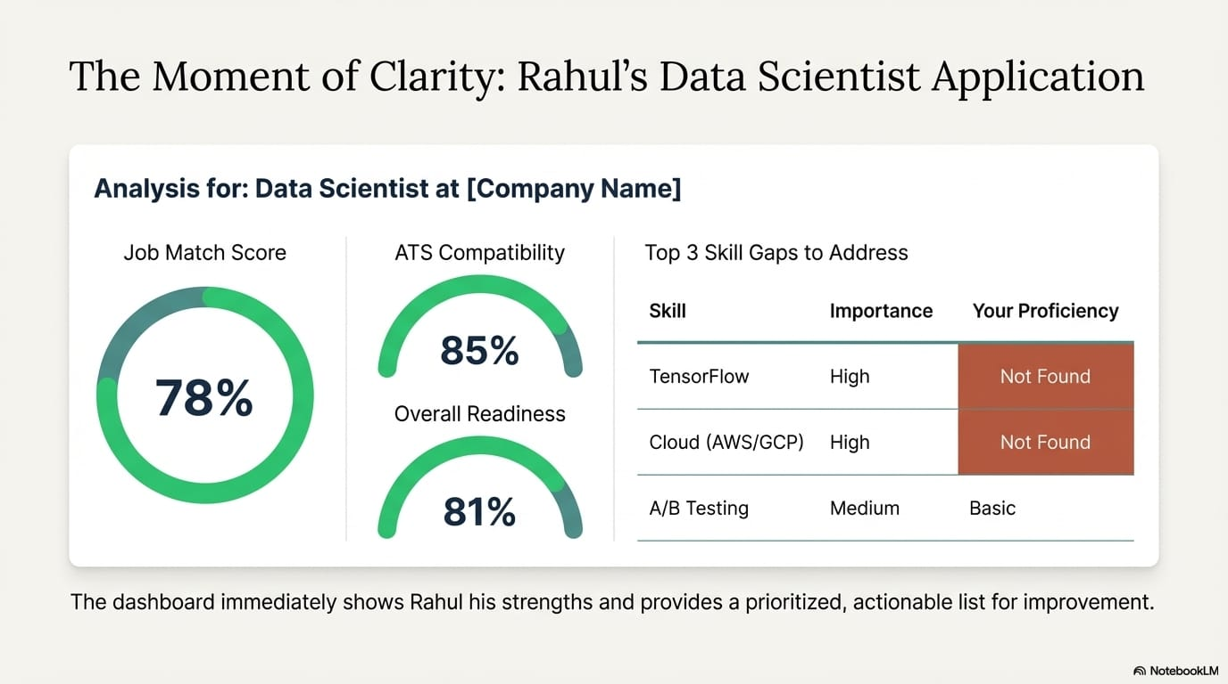
System working Overview

Slide 9
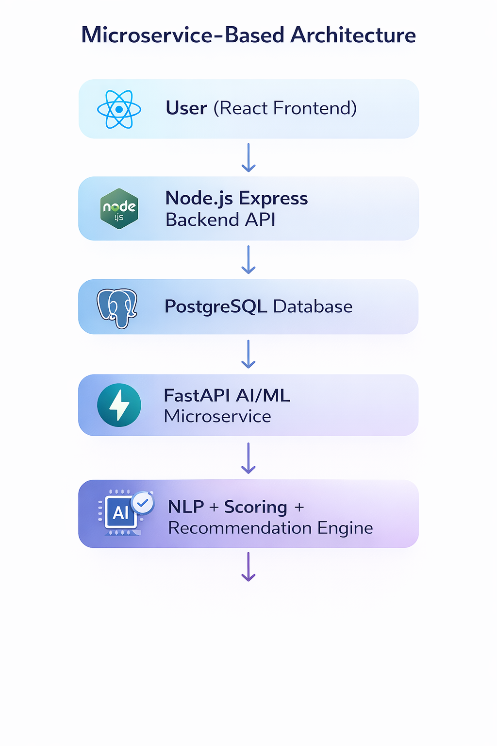
System Architecture
Microservice-Based Architecture
User (React Frontend) ↓ Node.js Express Backend API ↓ PostgreSQL Database ↓ FastAPI AI/ML Microservice ↓ NLP + Scoring + Recommendation Engine

Slide 10
Backend & Security:
JWT Authentication (Access & Refresh Tokens)
Google & GitHub OAuth Login
Secure password validation rules
Rate limiting for authentication routes
Resume upload with PDF parsing
Active resume management system

Slide 11
Work Done :-
🔹 AI/ML Work
NLP skill extraction
ATS scoring logic
Skill gap detection
Chatbot Integration
ccg
🔹 Backend Work
Authentication(JWT+Oauth)
API Development
Resume Upload & Parsing
Database Integration
🔹Frontend Work
User dashboard
Resume upload UI
Result visualization
Chatbot UI

Slide 12
Unique Features
Improvement roadmap instead of only scores
Weighted scoring vs keyword matching
AI-powered course & project recommendations
AI-Driven chatbot
OAuth-based quick login
Continuous profile monitoring

Slide 13

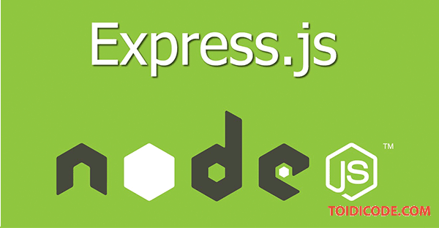
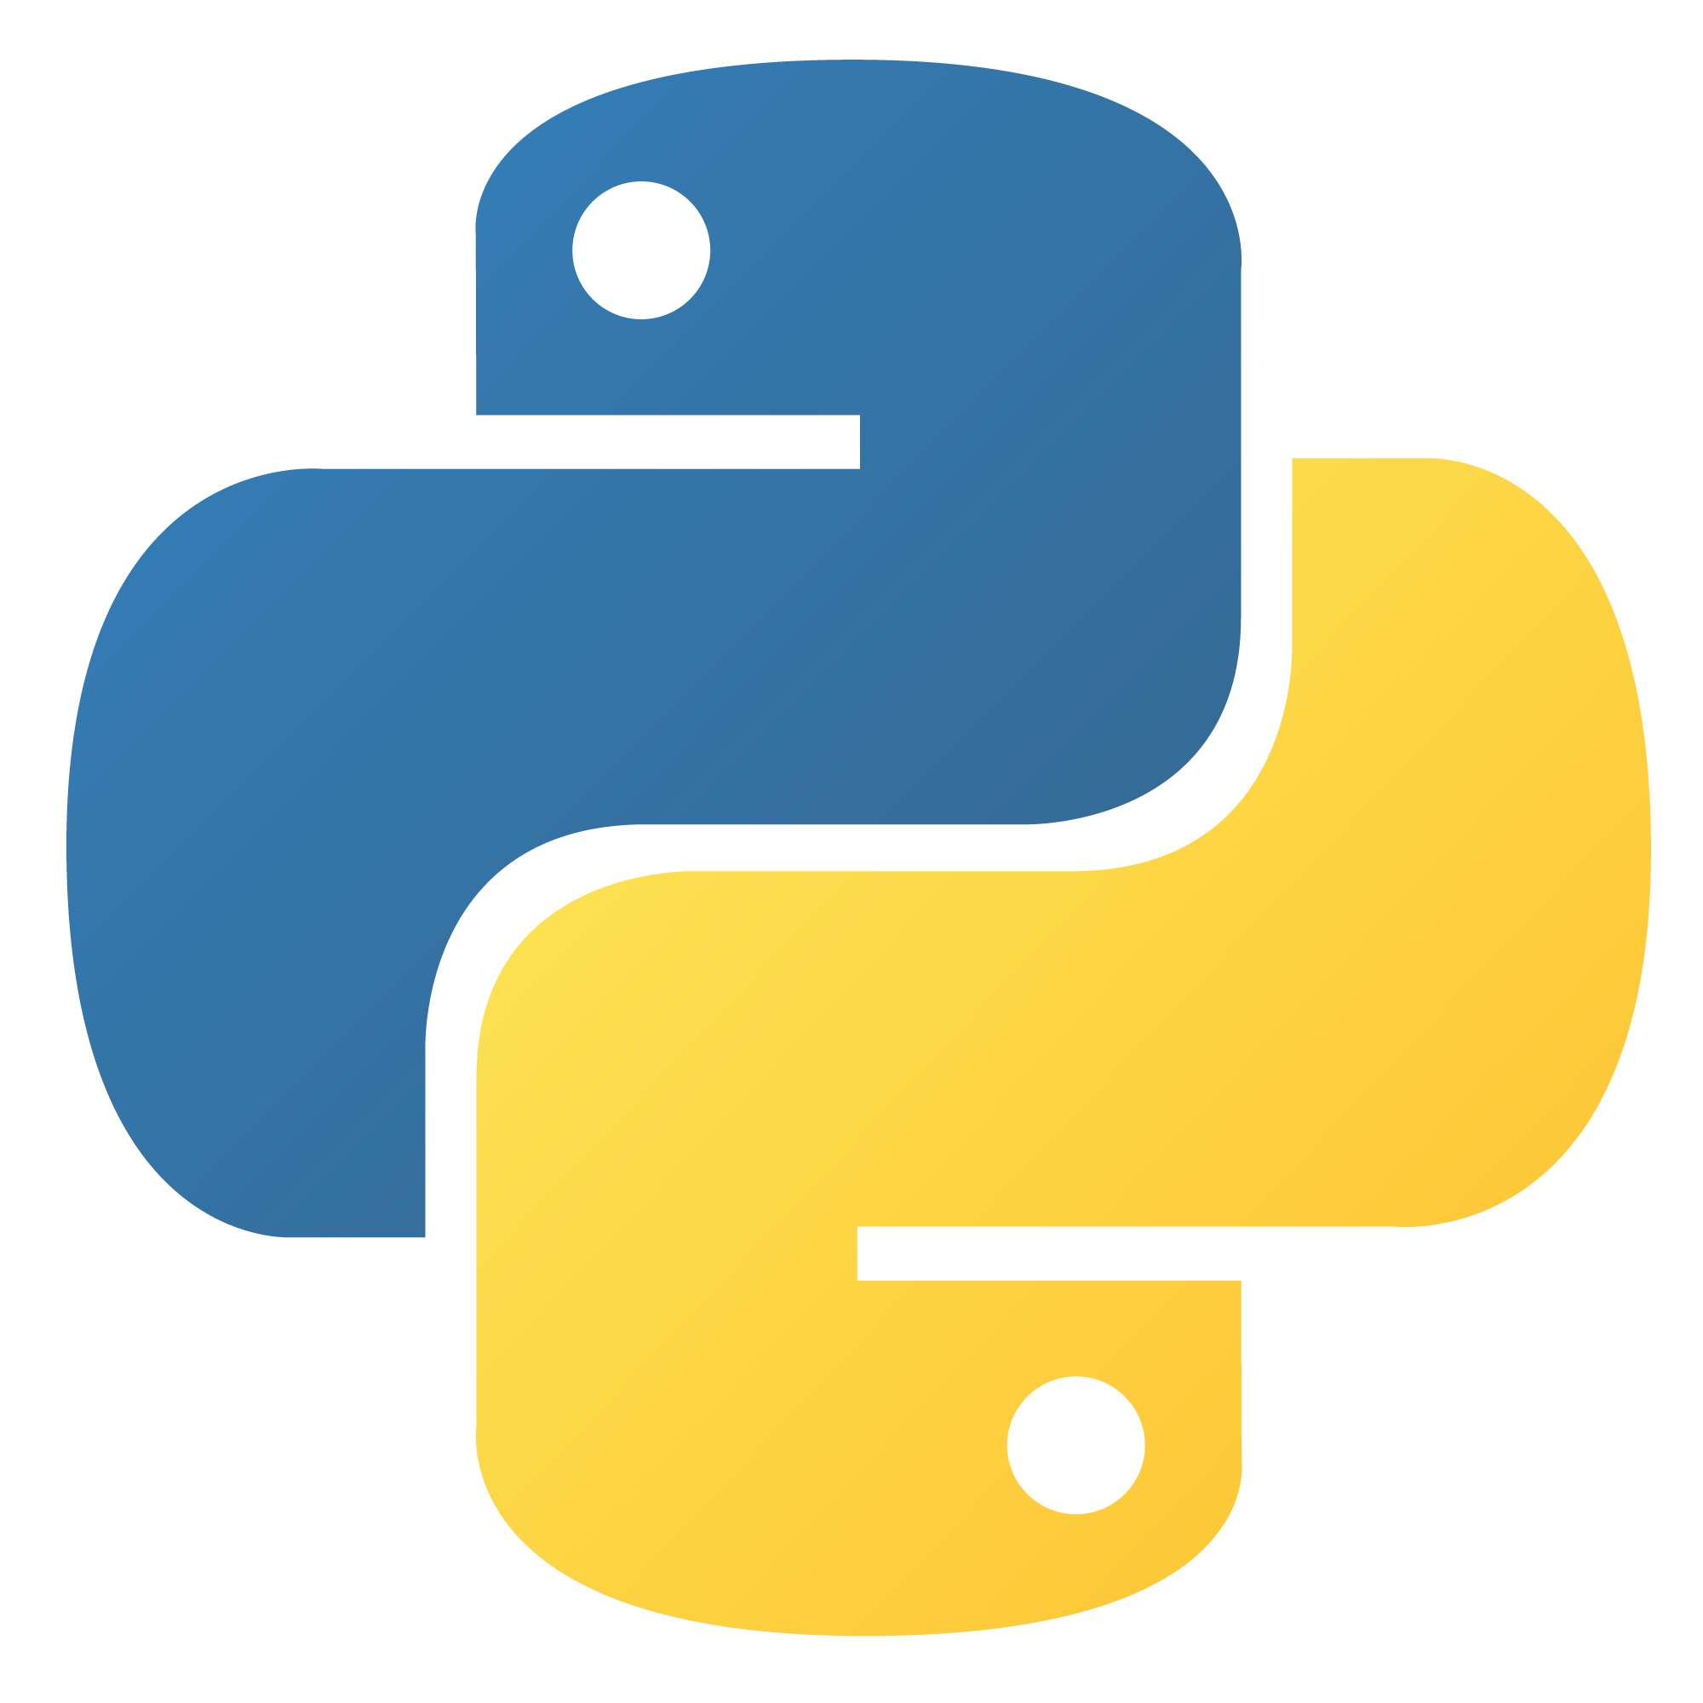


Tools & Technologies
Frontend
React.js
Backend
Node.js
Express.js
AI / ML
Python & Libraries
FastAPI, NLP
spaCy, NLTK
Authentication
JWT
Passport.js (Google & GitHub)
Database
PostgreSQL

Slide 14
Conclusion:-
The AI-Based Career Intelligence System provides an intelligent approach to resume analysis and career guidance.
It helps students identify skill gaps and understand their readiness for specific job roles.
AI and NLP techniques automate resume evaluation and job matching with improved accuracy.
The system generates ATS scores, job match scores, and personalized recommendations.
A structured learning roadmap guides users toward continuous skill improvement.
Overall, the platform bridges the gap between academic learning and industry requirements.

Slide 15
THANK YOU!! Questions….?

